Slide 1
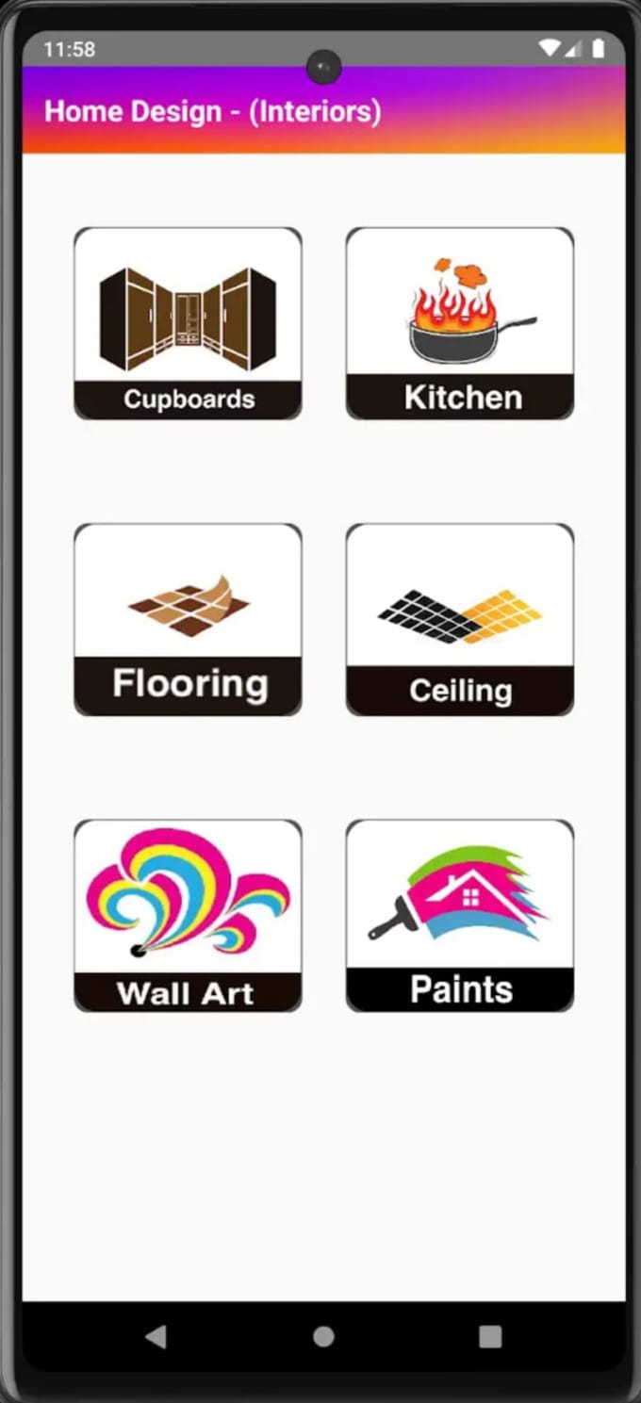
An Android Based Application For Revolutionizing Home Design
BATCH- IT-1
K.V. Hemanth -207Z1A1225
Sheldon Shaji -207Z1A1241
V.Nikil -207Z1A1248

Slide 2

Implementation
Steps to Implement
Step-1 : Install the Android Studio.
Step-2 : Write the code.
Step-3 : Debug and Run the code.
Step-4 : The Output will be Displayed.
Play Store Link:
https://play.google.com/store/apps/details?id=com.home.design.plans

Slide 3
Source Code
AndroidManifest.xml:
<?xml version="1.0" encoding="utf-8"?>
<manifest xmlns:android="http://schemas.android.com/apk/res/android"
xmlns:tools="http://schemas.android.com/tools">
<application
android:name=".utils.MyApplication"
android:allowBackup="false"
android:icon="@mipmap/ic_launcher"
android:label="@string/app_name"

Slide 4
<activity android:name=".activities.MainActivity" />
<activity android:name=".activities.ColorsActivity" />
<activity android:name=".activities.Exteriors250Activity" />
<activity android:name=".activities.ImageViewerActivity" />
</application>
<queries>
<package android:name="com.whatsapp" />
</queries>
</manifest>

Slide 5

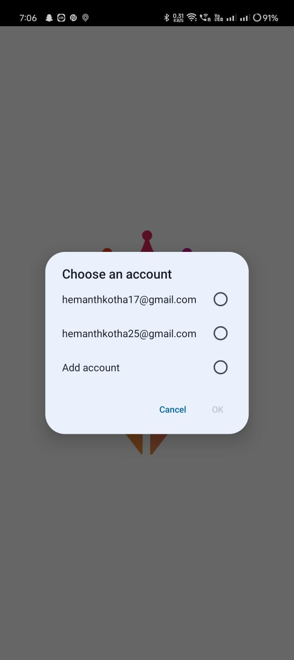
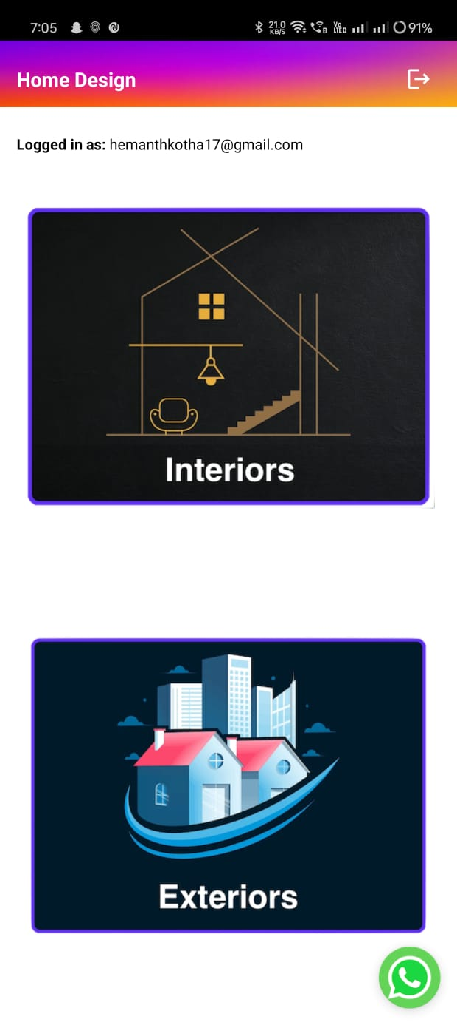
Output Screens
(a)Splash Screen
(b)Login Screen
(c)Home Screen

Slide 6
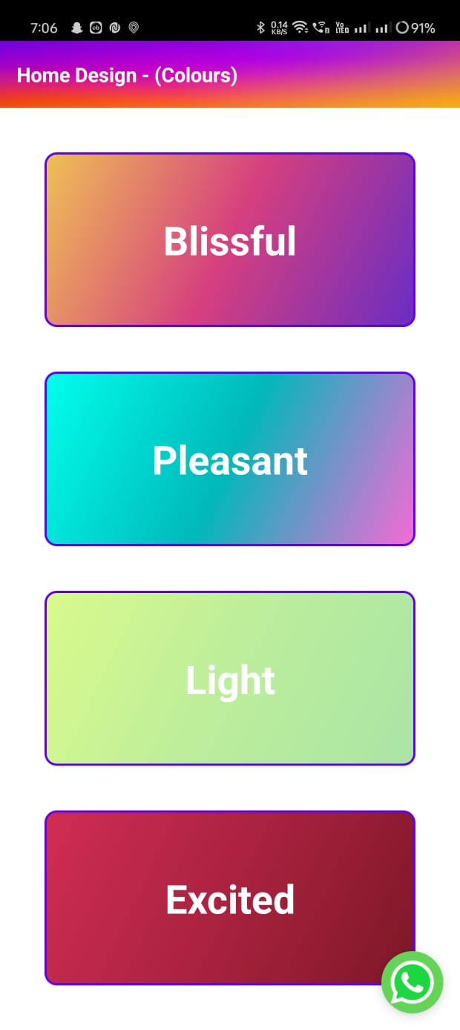
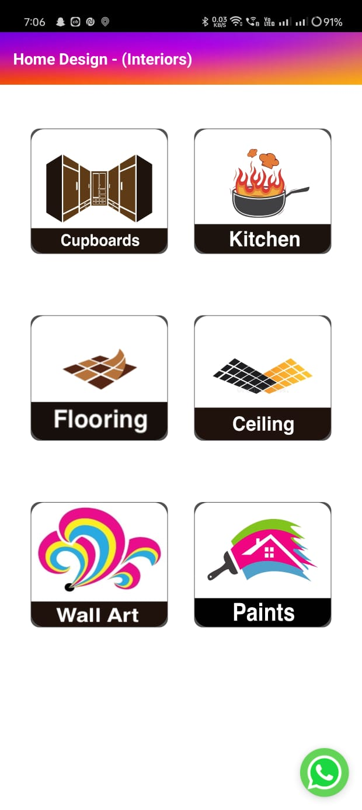
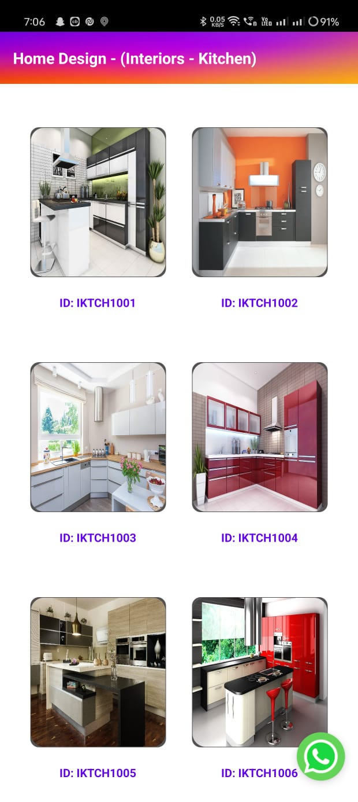
(d)If we click the Interior then Filters Screen in Interior Displayed
(e)Interior Options Screen
(e)Interior Kitchen Designs Screen

Slide 7
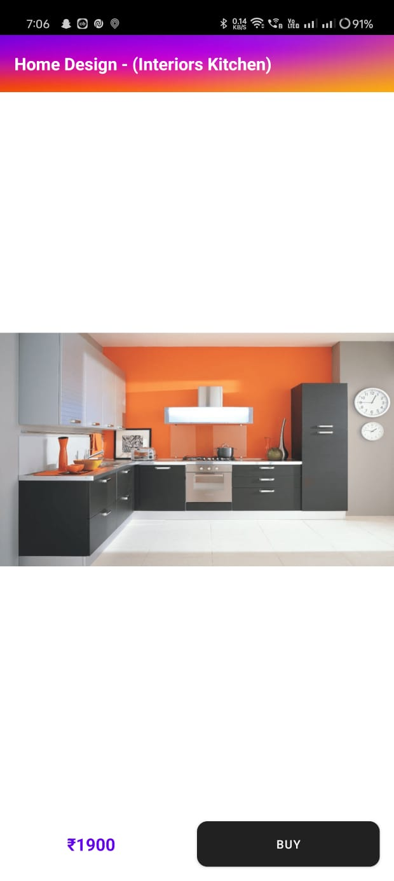
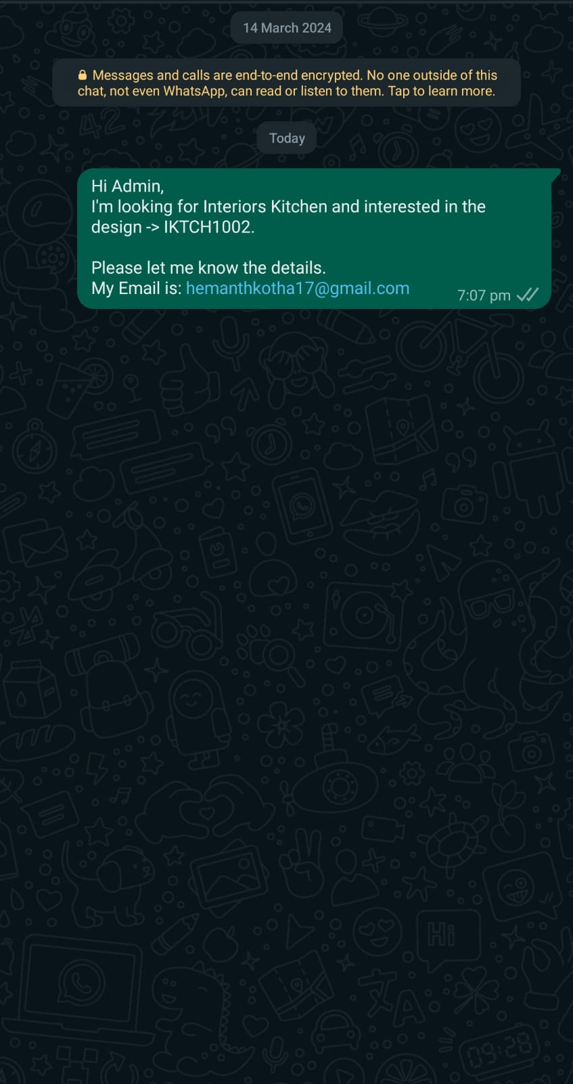
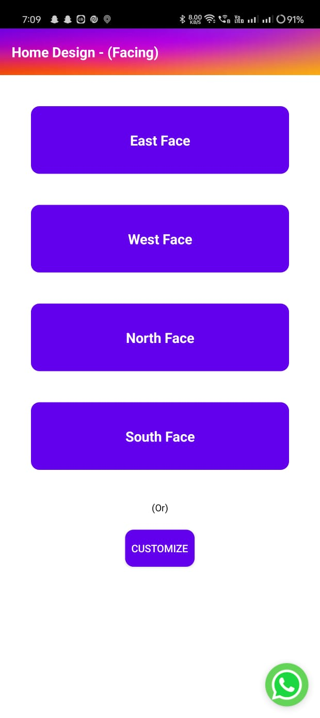
(f)If we chosen any Image then it displays in this screen where you can zoom in and zoom out
(g)If we click the Buy button then it will redirect to the what’s app communication with the predefined text.
(h)If we click the Exterior then Filters Screen in Exterior Displayed

Slide 8
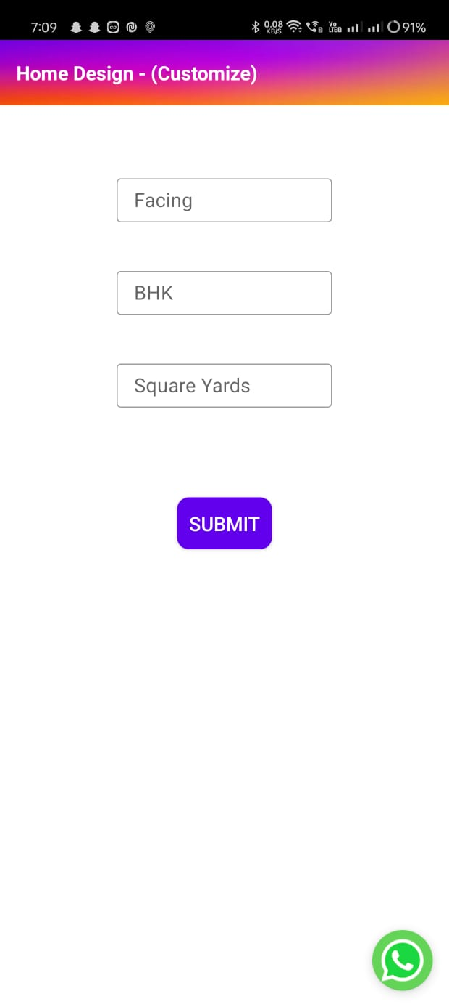
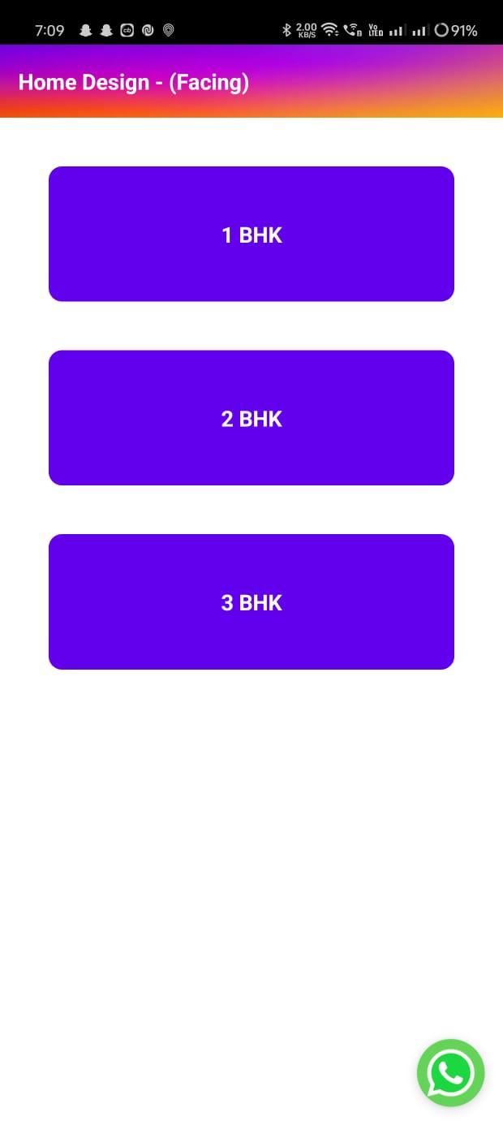
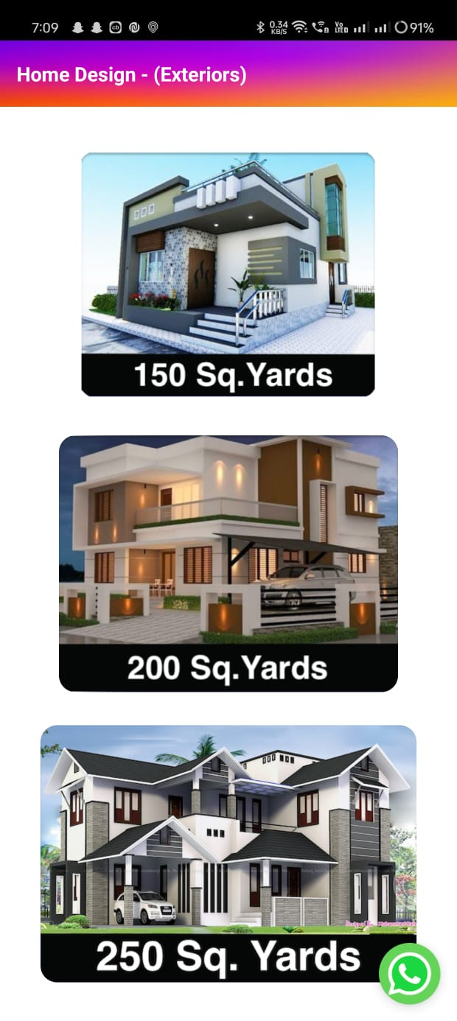
(i)If we chosen any customize then it displays this screen.
(j)We need to select BHK’s in this screen.
(k)we need to choose sq.yards in this screen.

Slide 9
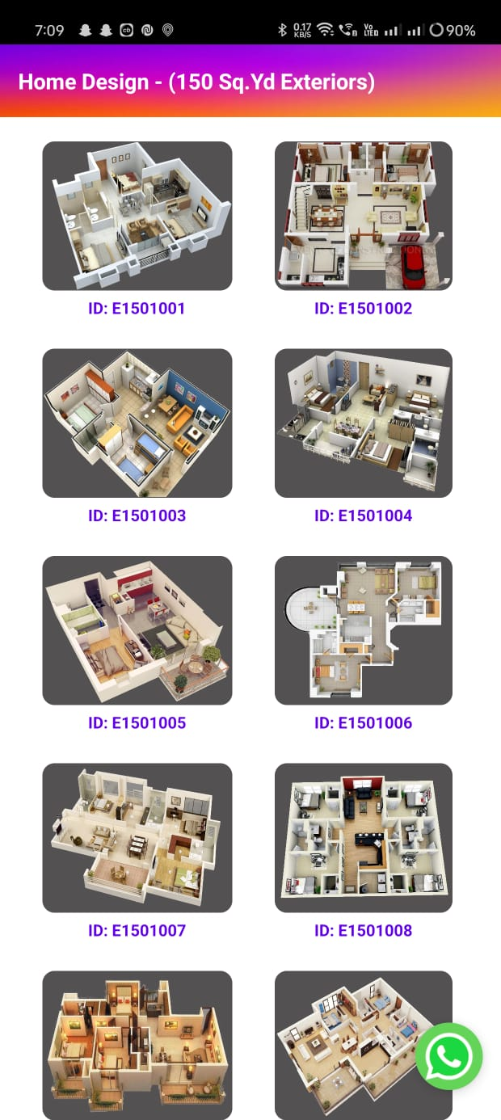
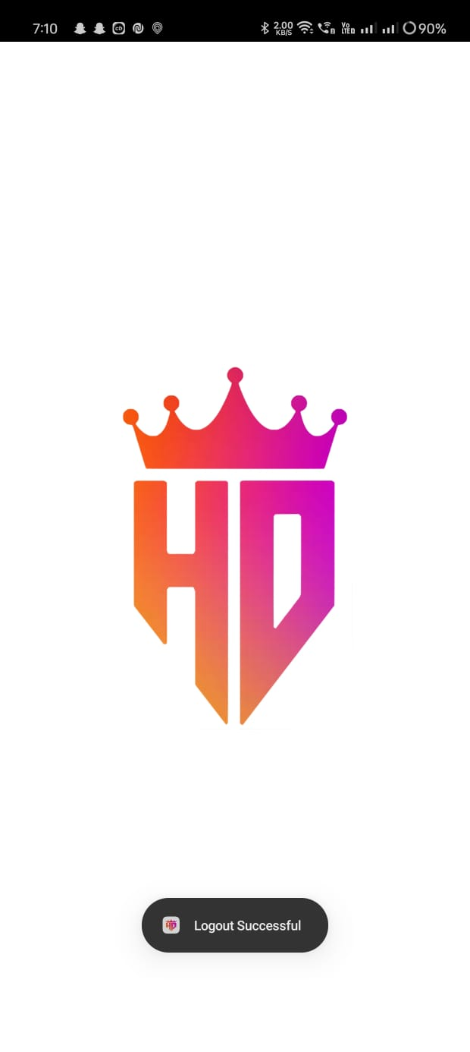
(i)Logout Screen
(i)If we chosen any Sq.yards then this screen will be displayed.

Slide 10
Admin
When the “Admin” will receive that message through the Application.
It contains the “Unique ID” based on that ID admin will be able to identify the Design which the user has been Selected.
So, For the Identification of the Design. Here there is output screen of the WebApp for the Application.
Which is Completely accessed by the “Admin” itself.
Link: https://roaring-tapioca-b2866a.netlify.app/

Slide 11
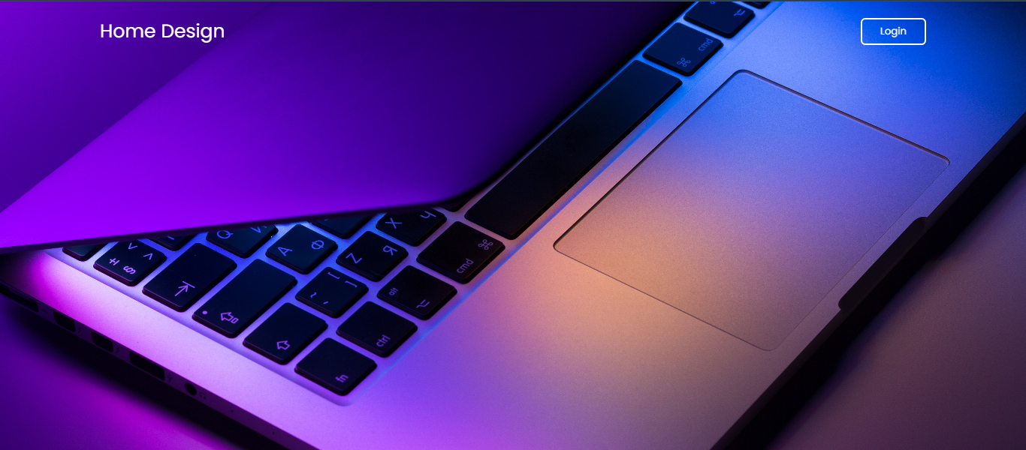

A)Login Page
B)Home Page

Slide 12
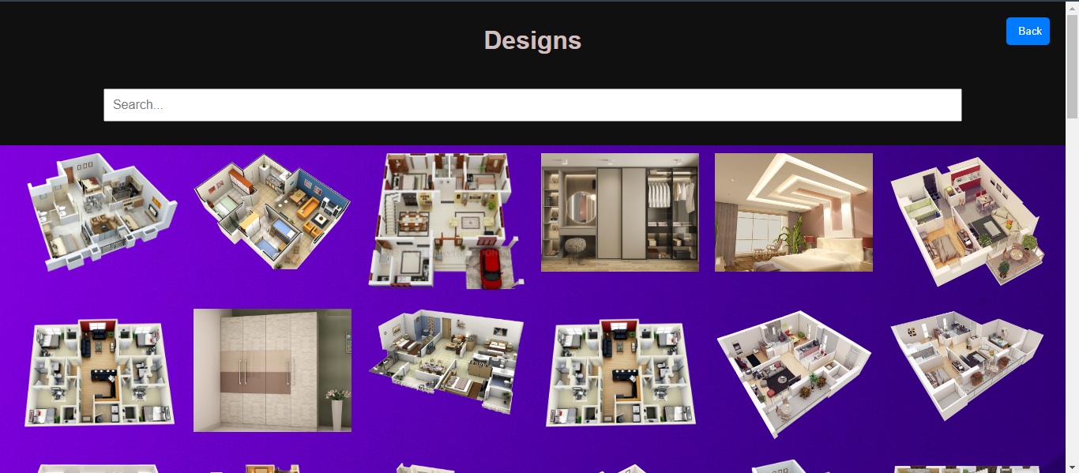
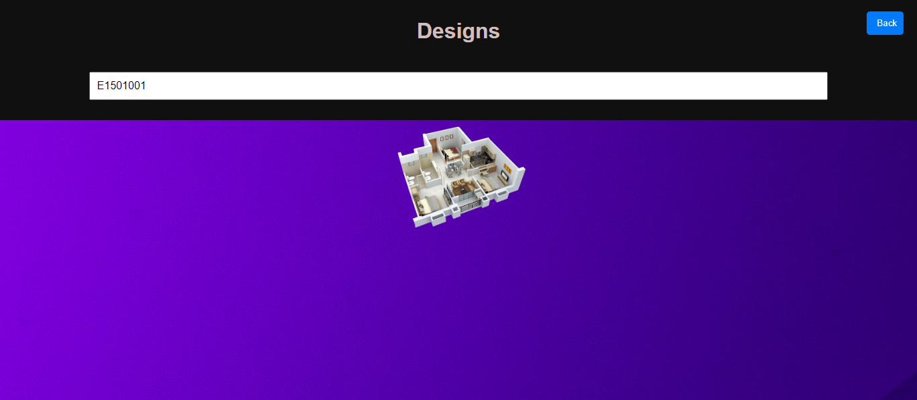
C)Designs Page
D)Filtered Page based upon the ID.

Slide 13
Test Cases
TEST CASE ID | TEST CASE DESCRIPTION | INPUTS | EXPECTED OUTPUT | ACTUAL OUTPUT | STATUS
1 | Splash Screen | The user should open the App. | Splash Screen should be displayed. | It has been displayed. | Success
2 | Login | Google Auth. | Choose an account | Screen has been Displayed. | Success
3 | Add the account(Login) | Google Auth using the API. | Give Credentials like username and password. | The user has successfully logged in. | Success
4 | Dashboard | It will display both Interior & Exterior. | It has displayed Interior & Exterior. | The dashboard screen. | Success
5 | Filters | In both Interior & Exterior Screen based upon measures. | It will Display the filters like colors in interior & bhk’s, faces in Exterior. | It has been Displayed. | Success

Slide 14
TEST CASE ID | TEST CASE DESCRIPTION | INPUTS | EXPECTED OUTPUT | ACTUAL OUTPUT | STATUS
6 | Options(Interior-cupboards,etc & Exterior-Sq.yard) | Based upon the Chosen only the designs will be displayed. | To Explore the designs for that options. | The user will be redirected to the designs screen. | Success
7 | Designs. | It will display the Images with Id’s. | It will display the designs. | After Choosing the design we need to click Buy now. | Success
8 | Communication Channel. | It will open with some pre-defined text. | It will display the message. | The message has been displayed. | Success
9 | Logout Screen | The user have to sign-out from the Application. | Users had successfully logged out. | It will display the Logout Successful. | Success

Slide 15
THANK YOU

